Slide 1
Community Outreach and Overdose Prevention Partnerships
Needed Interventions During the Opioid Crisis
November 16, 2020

Slide 2
Agenda
Harm Reduction and Recovery
Assertive Street Outreach Model
Telehealth and MAR partnerships
State/local strategies to promote effective interventions and prevent overdose deaths

Slide 3
Harm Reduction in Action - Any Positive Change
Point of engagement
Help people have increased control over their substance use and lives.
Assist with helping people build up the pillars needed for foundational recovery.
The experience of positive change can lead to one experiencing hope that there is support out there for building up the pillars for foundational recovery, step-by-step, one positive change at a time.

Slide 4
SAMHSA Definition of Recovery
Four major dimensions that support a life in recovery:
Purpose: having meaningful daily activities, such as a job, school, volunteerism, family caretaking, and the independence, income and resources to participate in community activities.
Home: having a stable and safe place to live.
Community: having relationships and social networks that provide support, friendship, love, and hope.
Health: having access to care for overcoming or managing one’s disease(s) or symptoms, including physical and behavioral health, and making informed, healthy choices that support physical and emotional wellbeing.

Slide 5
Assertive Street Outreach to Prevent Overdose
Essential Components and Partnerships

Slide 6
Background: How This Model Began
The following is a summary of what we’ve found to be “ingredients” essential of a comprehensive street outreach model.
Starting in Late Spring 2020 our program at Thresholds has been teaming up weekly with Prevention Partnership (lead organization of Westside Opioid Task Force), The Night Ministry and CPD District 11.
Each organization brings something essential to the outreach effort. Implementing the model has been possible because of our collaborative approach.

Slide 7
Street outreach - led by people who have the lived experience
The street outreach effort needs to be led by people who have the lived experience of homelessness and recovery from substance use and /or mental health conditions.
Their partnership is essential for conveying hope and expectancy that this type of engagement can be trusted and will make a positive difference in their lives.

Slide 8
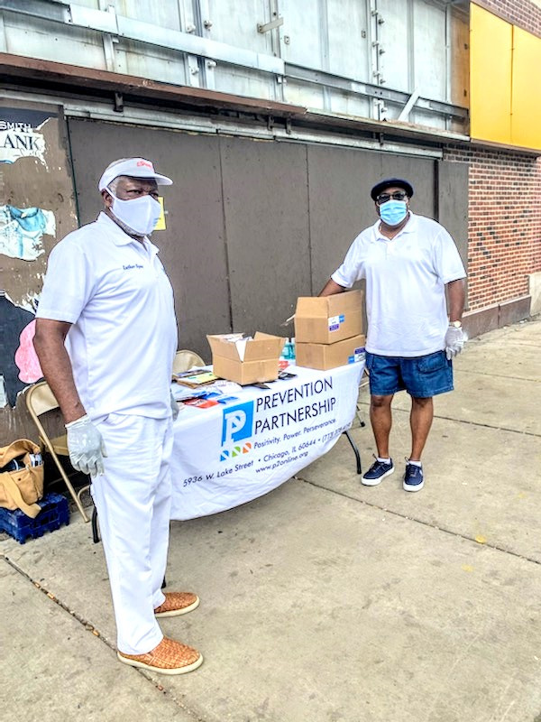
Offer Free PPE
Offer free PPE to decrease the spread of COVID-19. Most people are in need of PPE and convey gratitude when offered a mask and hygiene packet.

Slide 9
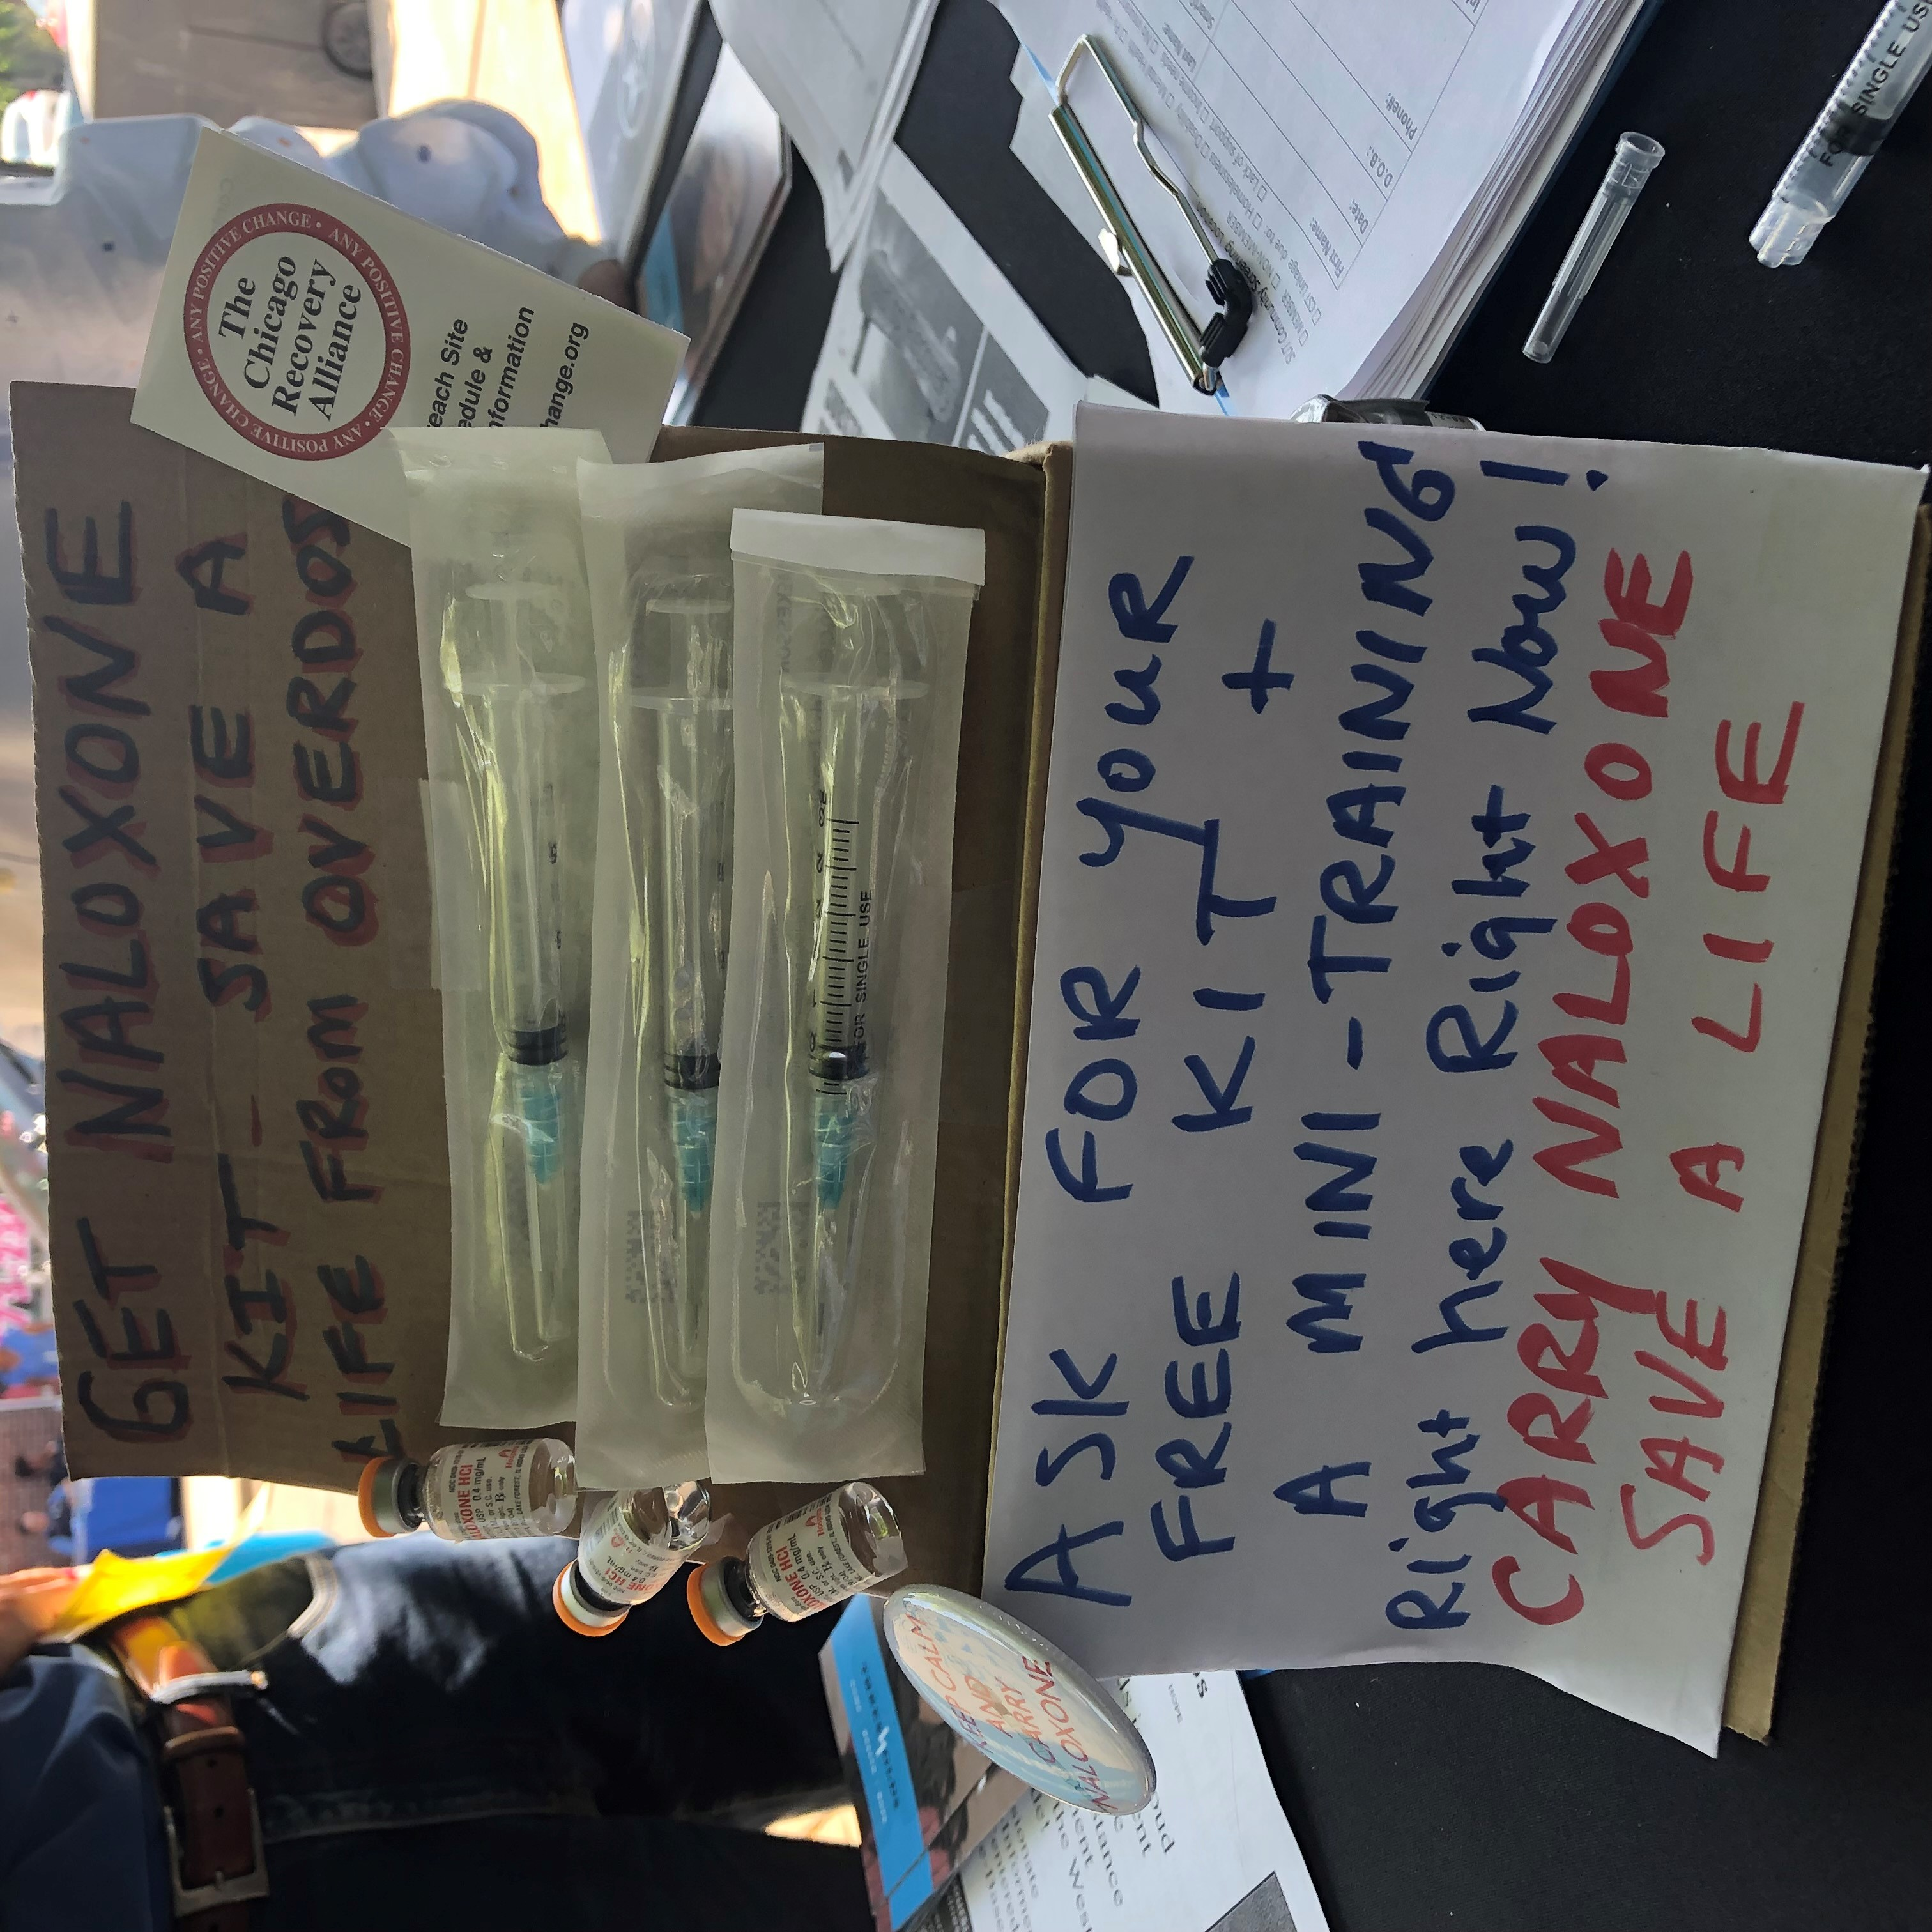
Offer Free Naloxone
Offer training on overdose prevention and reversal and free Naloxone Kits.
Most people living along the Pulaski Corridor know someone who has experienced an accidental opioid overdose.
There is a strong interest learning how to administer naloxone and receiving free naloxone kits.

Slide 10
Offer an Array of Substance Use Treatment Options
When people identify wanting to initiate substance use and/or mental health recovery, provide linkage to the type of substance use or mental health service that matches their level of motivation to address any positive change.

Slide 11
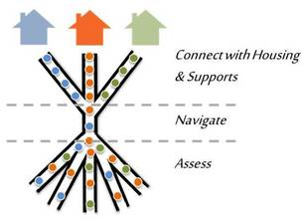
Offer Practical Assistance
Offer practical assistance to meet high priority needs identified by the person.
Start housing applications
Get State ID
Provide basic medical care, wound care, first aid
Connect with health care provider for MAR

Slide 12
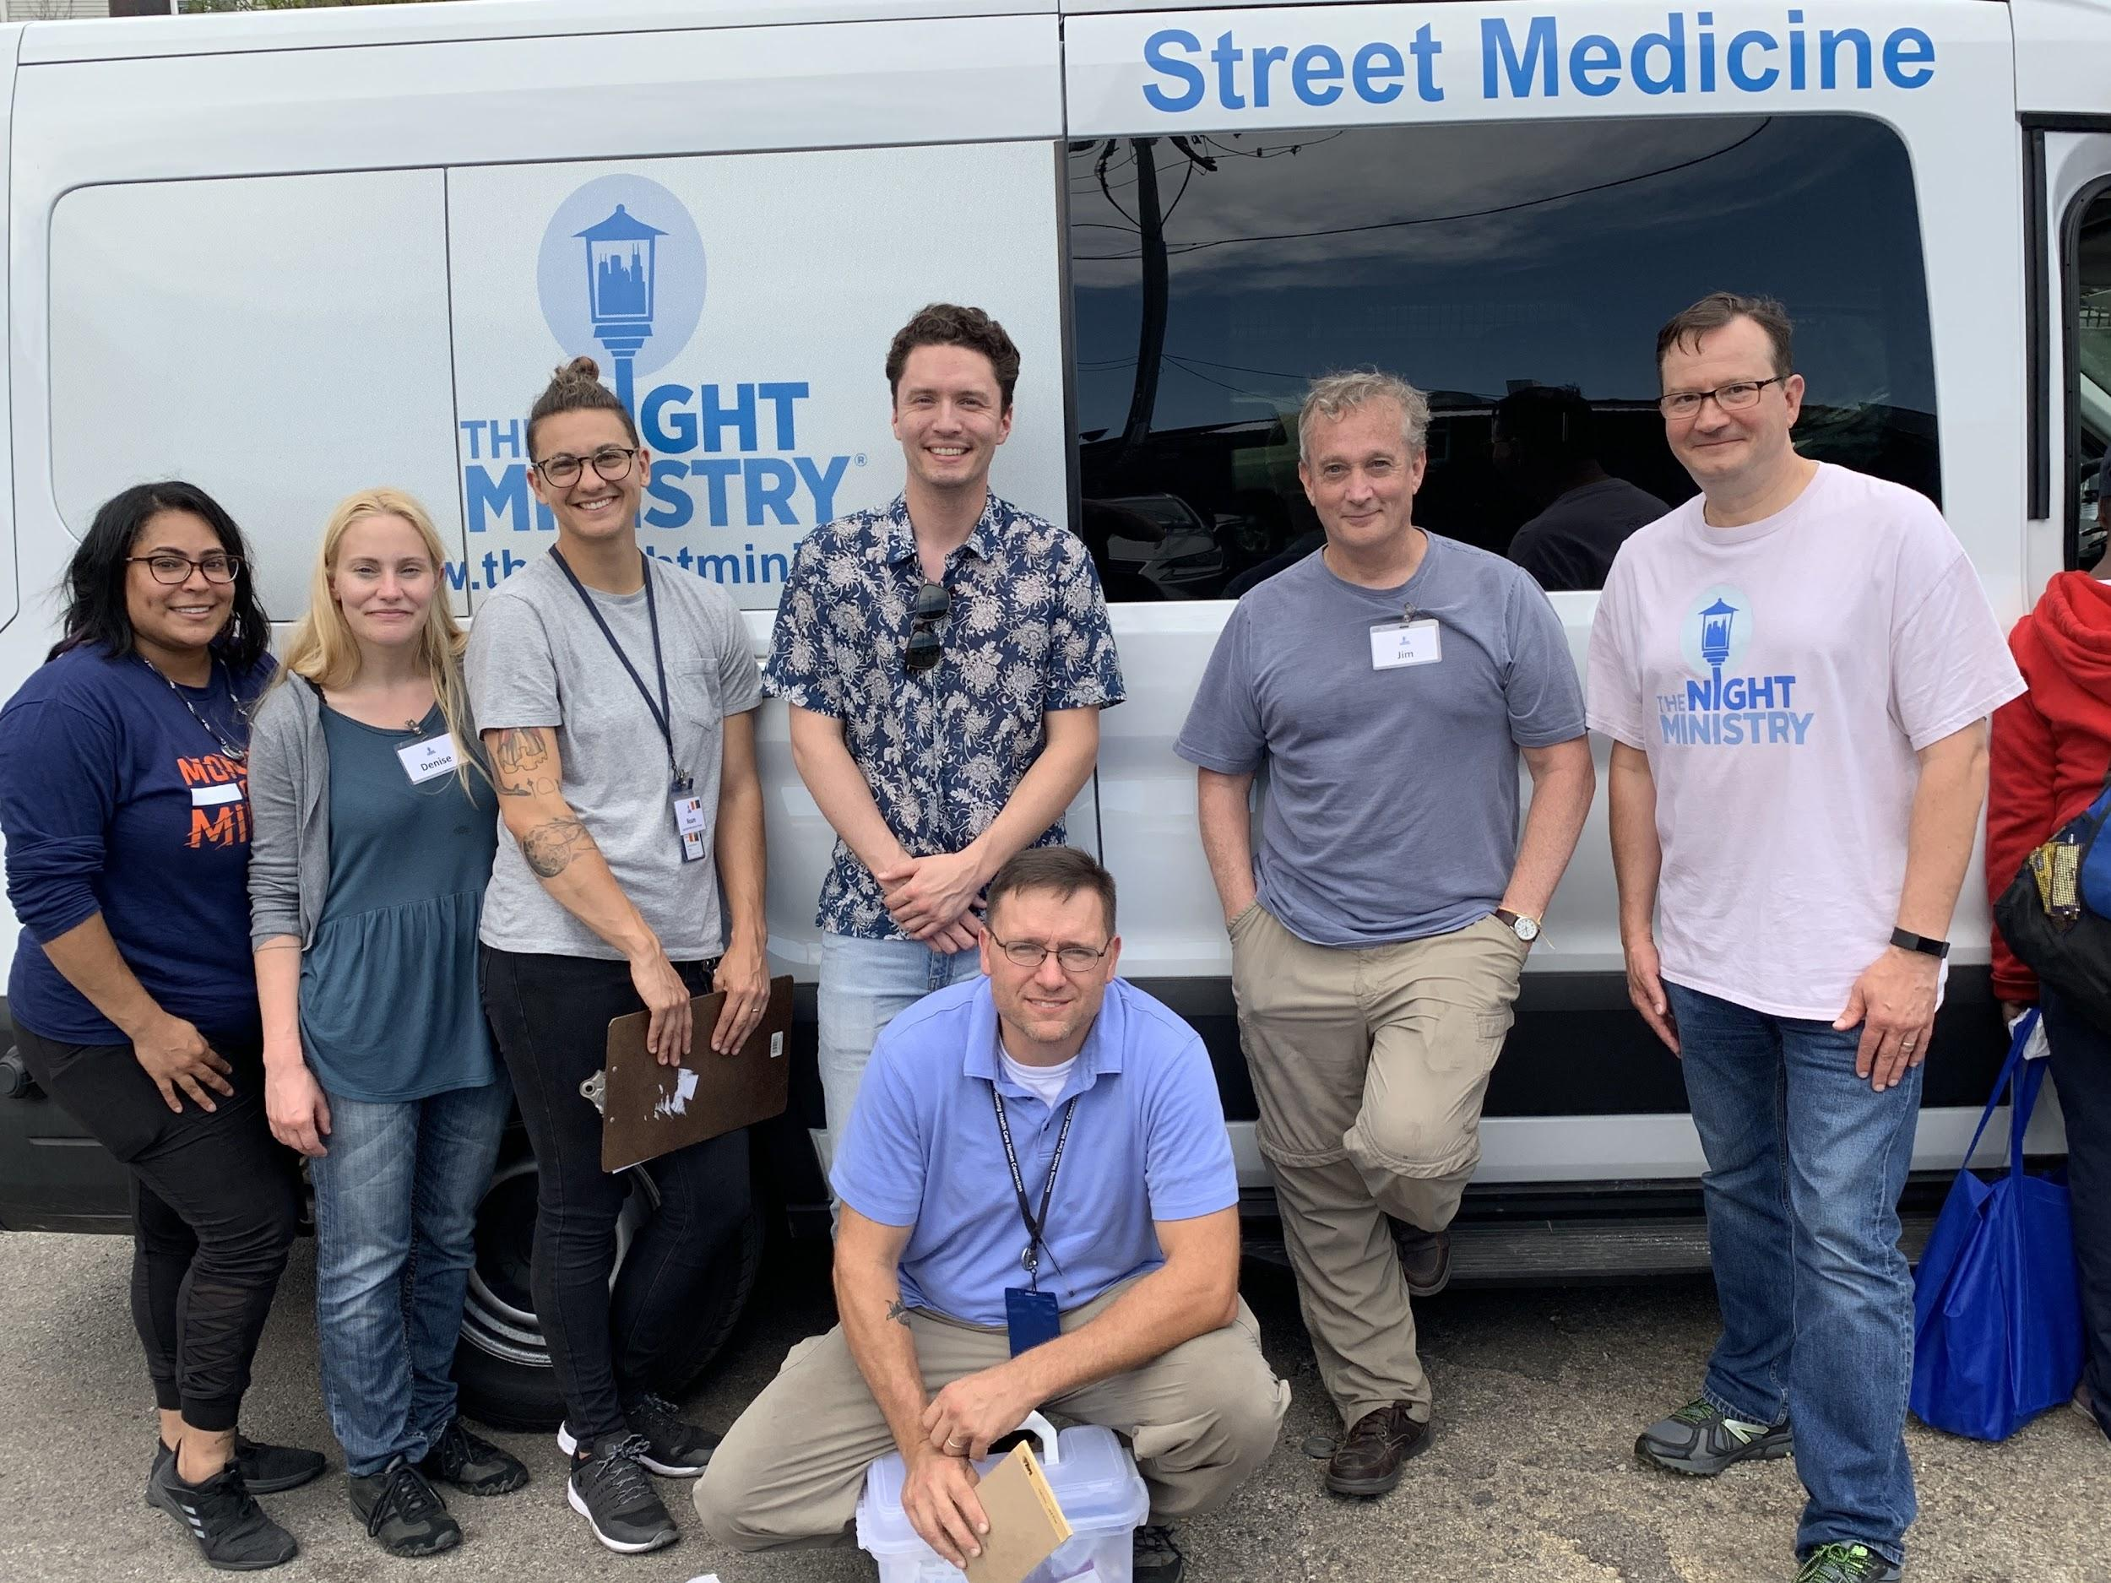
Mile Square and The Night Ministry: Developing Telemedicine for Mobile Outreach

Slide 13
COVID’s Silver Lining
Reduced restrictions at the State and Federal levels allow providers to bill Medicare/Medicaid for services provided via telemedicine: absolute game changer!!
Vital importance of low-barrier, real time MAT and Psych medicine management

Slide 14
Overview of Mile Square/Night Ministry Partnership
Components of initiating MAT for unstably housed, at-risk people
Scheduler/Insurance Navigator
Providers
MOU: PHI/HIPPA
Rx Funding from multiple sources
Weekly clinical call in
Off hours: on-call
Clinician access: Street Med cell and office numbers

Slide 15
Upon this foundation...
Bridging to Primary care and other specialties/services
Incorporating psychiatric medication management
A model for partnership with other FQHCs
Philosophy/Approach

Slide 16
Immediate Needs for Support on Westside
Immediately dedicate additional funds for community outreach teams and Naloxone training/distribution
Outreach and engagement is an essential component of harm reduction, treatment and recovery
Make SUD/MAR telehealth provisions permanent
Both state and federal proclamation
Convene community-based organizations to develop integrated outreach partnerships
FQHCs and behavioral health outreach teams

Slide 17
Vision for Addressing the Opioid Crisis
Sustainable reimbursement for community-based SUD/OUD interventions
Implement the Early MH and Addictions Act
Invest in low-barrier housing
Flexible Housing Pool and State Grants
Incentivize MAR induction at all levels
Overdose Prevention Sites

Slide 18
Questions and Discussion
Ann Brekke, Thresholds
Ann.Brekke@thresholds.org
Stephan Koruba, The Night Ministry
stephan@thenightministry.org
Dan Rabbitt, Heartland Alliance
(443) 401-6142; drabbitt@heartlandalliance.org
Prepared in collaboration with the Westside Heroin Task Force, UI Health, and Miles Square Health Center

